Slide 1
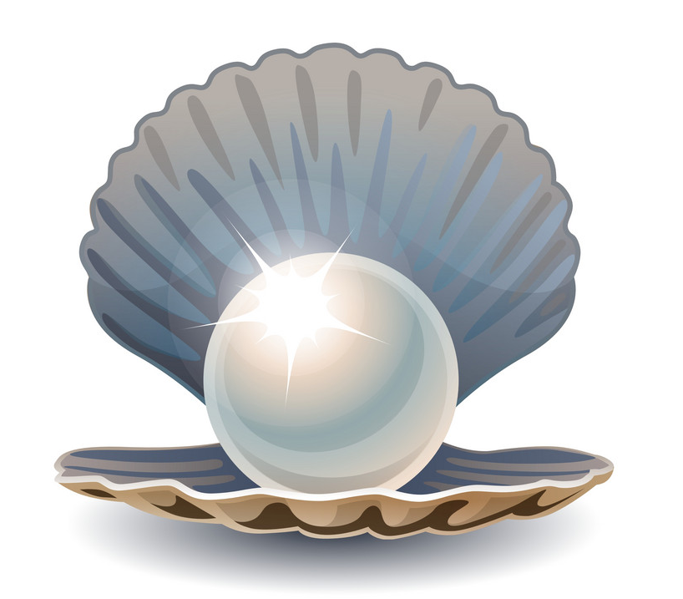

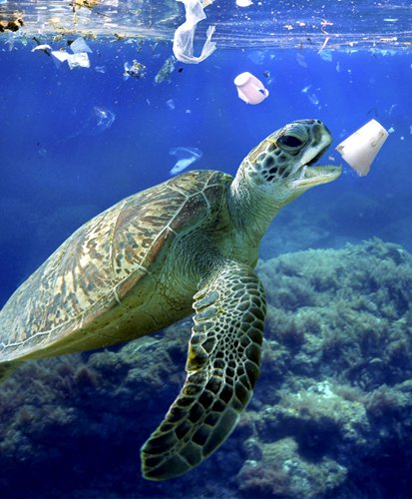
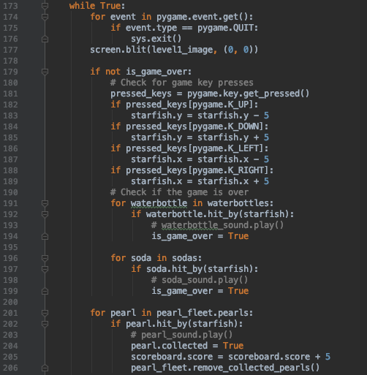
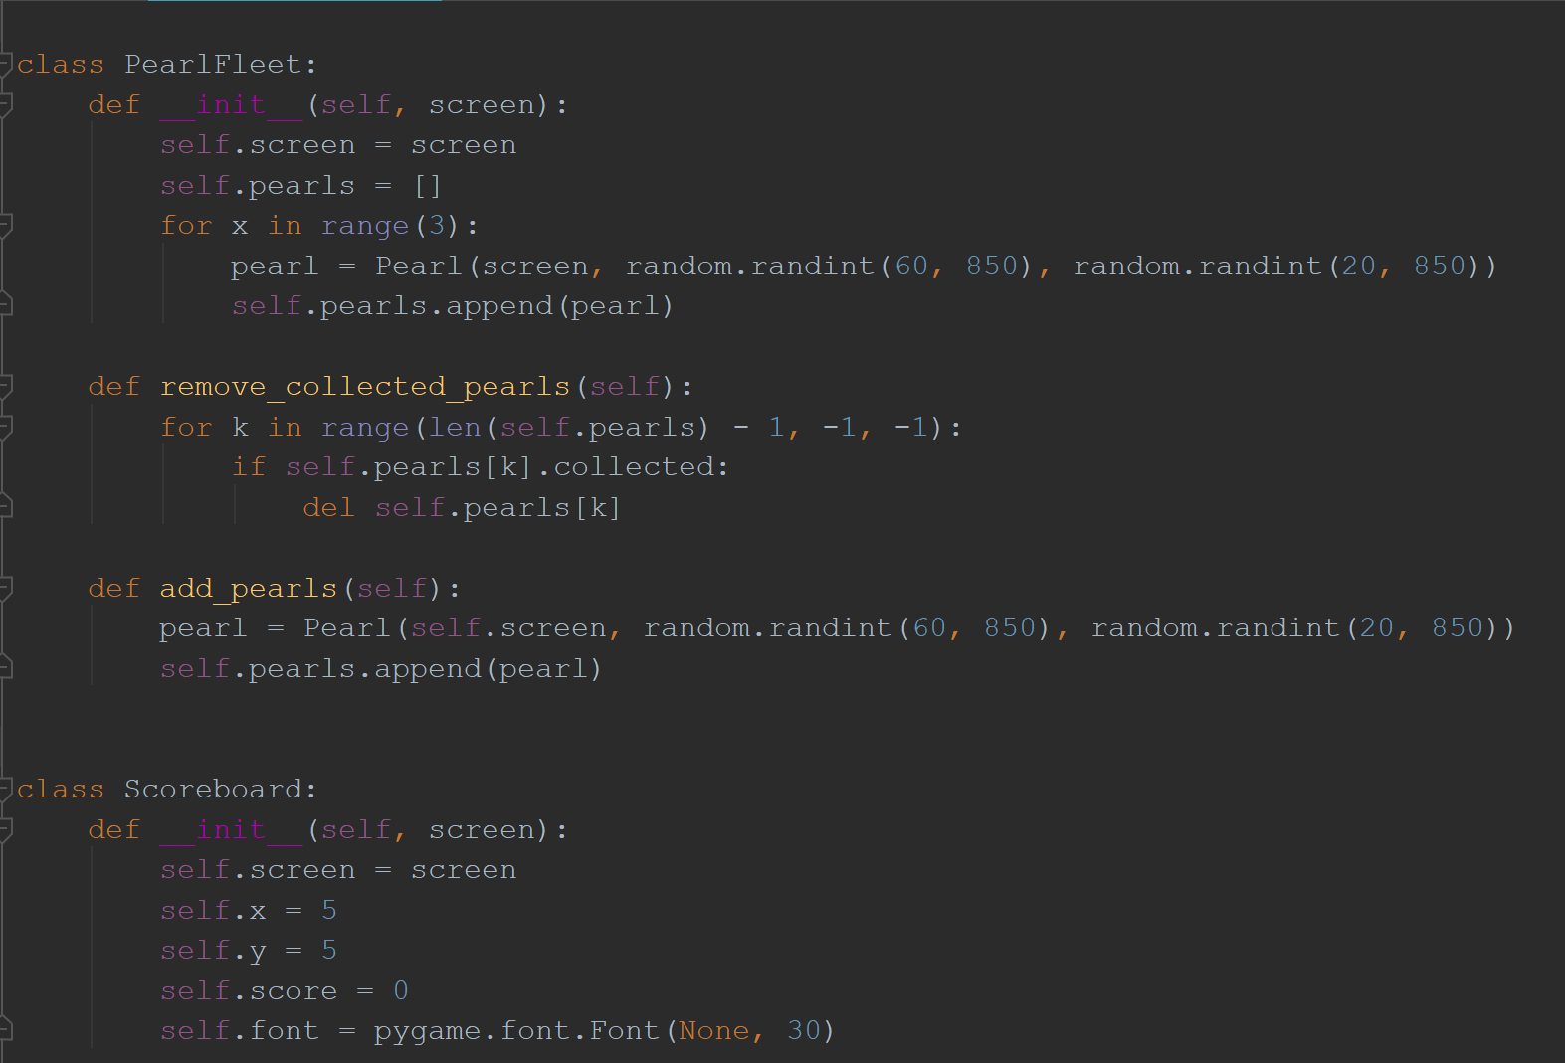



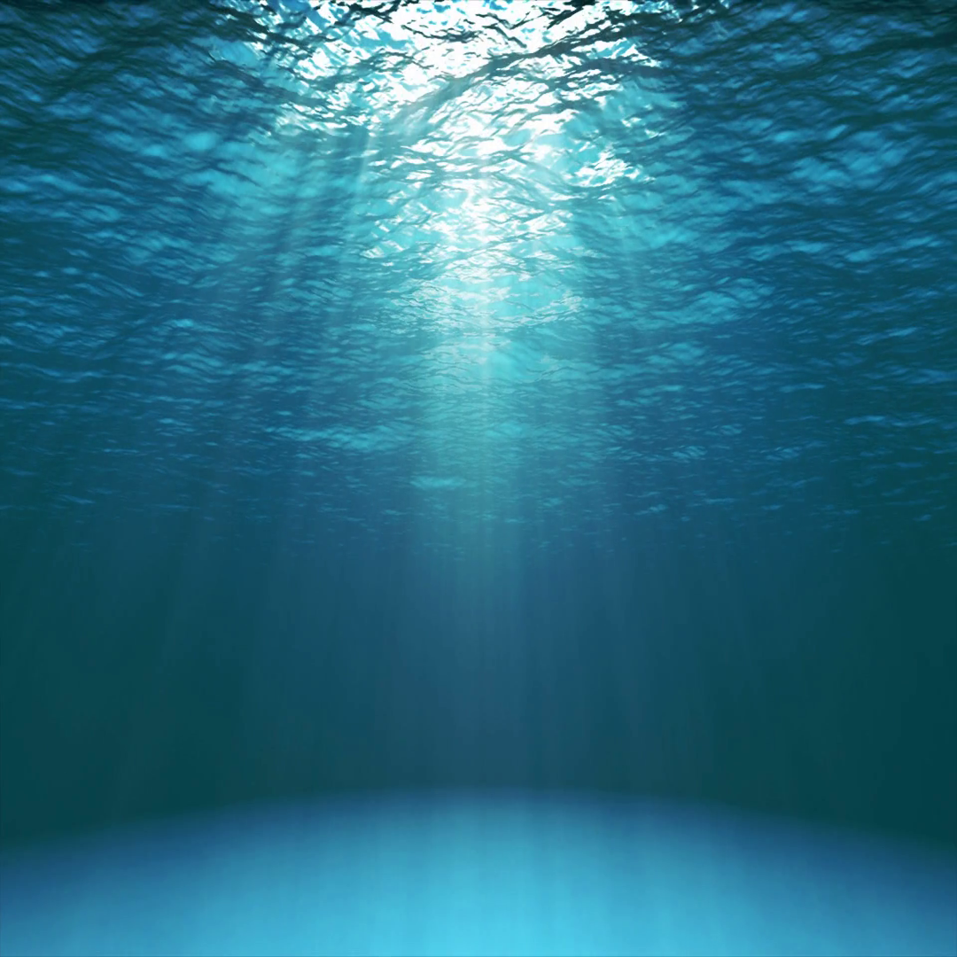
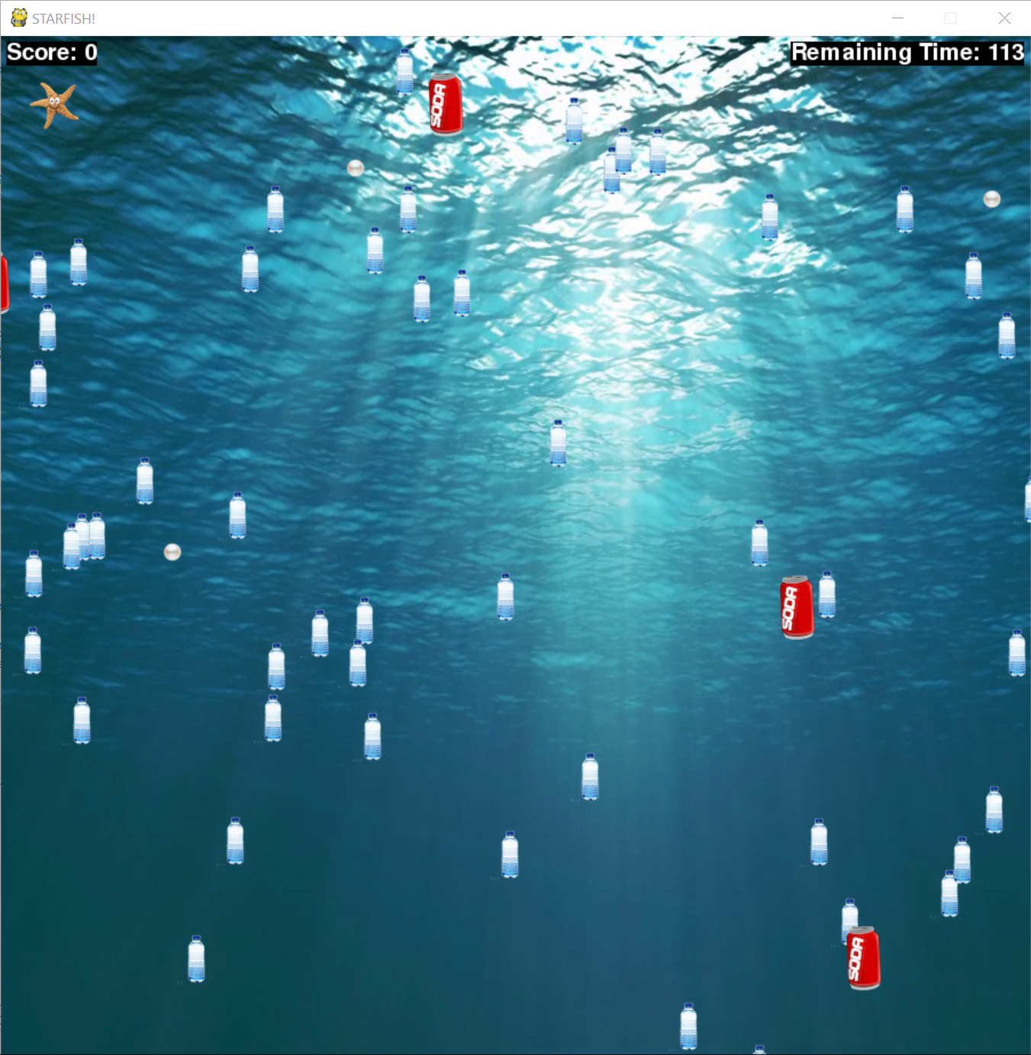
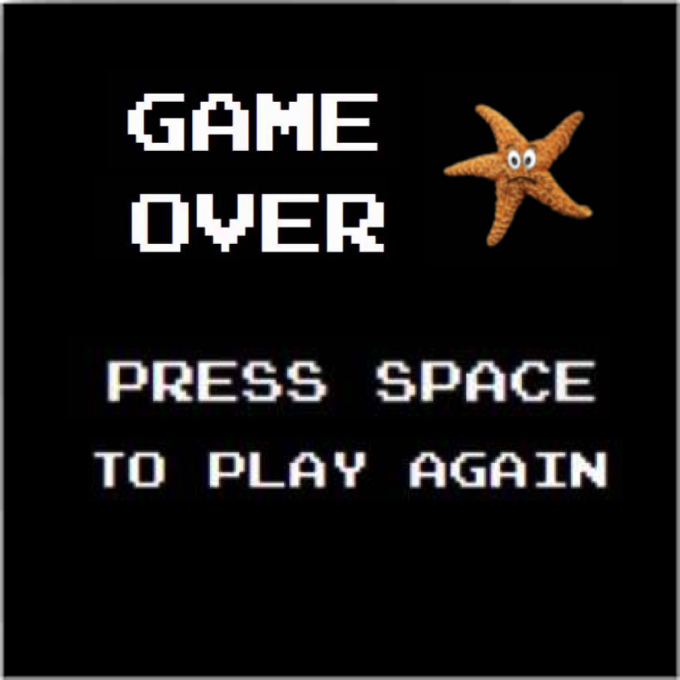
Team 10 - Rising Tides
Pearl Catch
Our ocean theme was inspired by our desire to bring awareness to the issue of pollution in the world’s oceans.
Operation Catapult 2019
Niharika Misal, Owen Greybill, Annelise Kezdy
Our game is an action game meant to engage the player with a challenging and changing course of obstacles, including moving barriers to keep the player on his or her toes. The goal of our game is to guide the starfish to collect pearls, which increases the score, while avoiding the trash in the ocean.
Design Approach
We wanted to design a game that challenges the player and has replay value. We liked the idea of a spin-off of the classic Snake game, but our design and ideas changed as we began the creation process. We continued to work with and add to our ocean theme until our game reached its final version. Our final product allows the user to navigate through debris in the ocean to collect pearls using the arrow keys.
What are classes?
Classes are a way to define an object or process which allows the main function to run the code.
Why does the sprite need member variables?
The sprite needs information to define itself. It needs to know what to display itself on (the screen!), where it is on the screen (x, y), and it needs to have an image of itself to display (image).
What are methods?
Methods are what the instance of the class can do. It includes information for the sprite about how to draw itself on the screen, how to move, and what to do when it is hit by another component on the screen, just to name a few!
A few of our classes and their components:
Procedure
Our first step was to brainstorm game ideas. Once we chose an idea, we began the project by gathering all the images needed for the background and sprites. Our organization style was to create a list of tasks and we chose a few tasks to complete every day. To keep our code neat, we completed tasks in the most reasonable order rather than in our initial listed order. Throughout the creation process, we tested our code and made various changes to our original design.
Class Name: | Water Bottle | Starfish | Soda
Member Variables: | screen x y image | screen x y image | screen x y image
Methods: | draw hit_by | draw move | draw move

